Slide 1
The Federal Judicial System
Ch. 14: Patterson

Slide 2
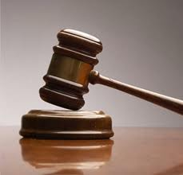
Other Courts
Most legal matters in the US are handled in state courts; 95%
Most crimes ranging from speeding to murder and most civil cases (lawsuits, divorce) are handled in state court
The lowest federal courts are the district courts; at least one in every state
District court is where most trials start and only level with a jury
Appealed cases go to a court of appeals; normally 3 judge panel hears appeal
Appeals courts are not a new trial, they review the lower courts actions to ensure proper procedures were followed

Slide 3
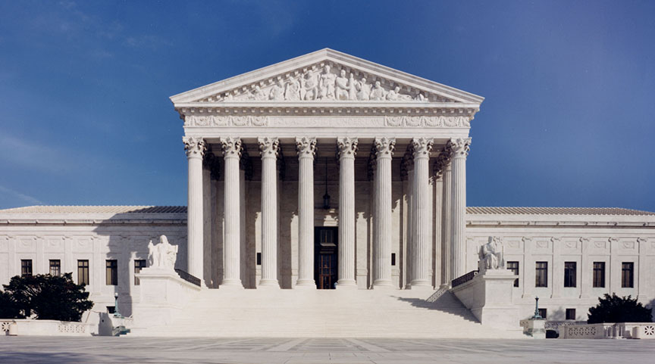
The Supreme Court
Supreme Court is found in Article III of the Constitution
Only court created by the Constitution, Congress creates lower courts
The Supreme Court stands above all other courts
Its main job is to decide whether laws are allowable under the U.S. Constitution, appellate court
Supreme Court has original jurisdiction in only two instances; it can preside over trials that involve diplomats from foreign countries and in disputes between the states
The Supreme Court is not required to hear all cases presented to it
The decisions of the Court are final and binding, no more appeals

Slide 4
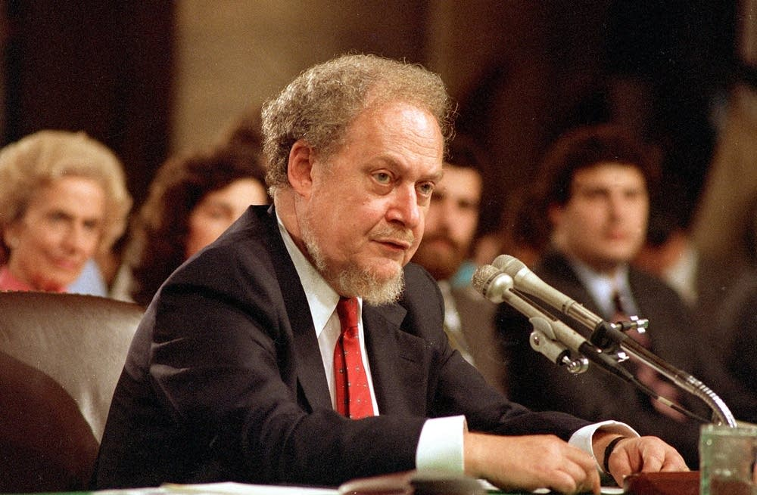
Supreme Court Justices
There are 8 associate justices and 1 chief justice
Congress sets this number and has the power to change it
The main duty of justices is to hear and rule on cases
The president appoints Supreme Court justices with the approval of the Senate when a justice dies or resigns
Presidents are careful to choose people that they believe the Senate will accept
The Senate has traditionally rejected many nominees based on doubts about their legal philosophy
Robert Bork was nominated for the Supreme Court but rejected by the Senate

Slide 5
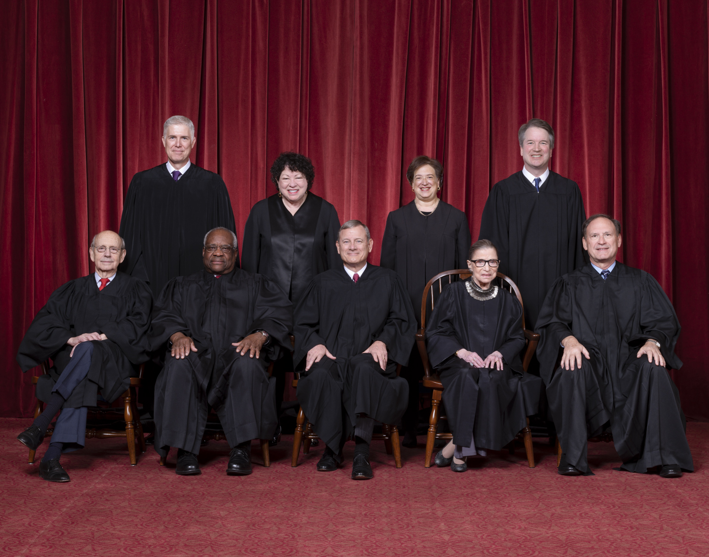
Background of the Justices
Supreme Court justices are almost always lawyers, why?
They have had successful careers practicing or teaching law, serving as judges in lower courts, or holding other public positions
Political support and agreement with the president’s ideas are important factors in who gets appointed; why?
The first African American justice, Thurgood Marshall, joined the court in 1967
The first female justice, Sandra Day ‘O Conner, was appointed in 1981
Today there are three females, one African American, and one Hispanic
All of the current justices were lawyers and/or judges before being appointed to the court

Slide 6
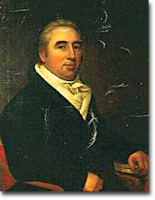
Judicial Review
The Constitution does not give the Supreme Court the power of judicial review
In 1803 the case of Marbury v. Madison established the concept of judicial review
On his last day in office John Adams appointed Marbury a justice of the peace, the new president Thomas Jefferson canceled the order the next day, Marbury sued
The decision in the case said: the Constitution is the supreme law of the land, if there is a conflict between the Constitution and any other law the Constitution rules, and the judicial branch gets to make that decision
William Marbury

Slide 7
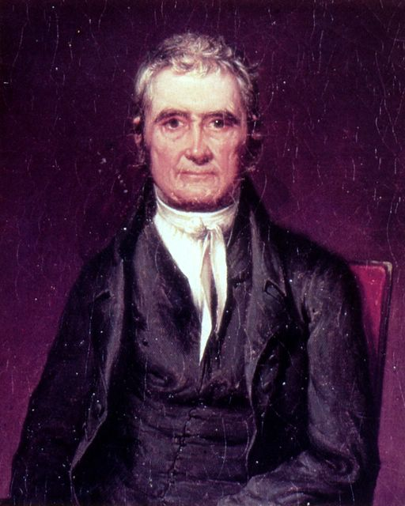
Interpreting Laws
John Marshall, who wrote the opinion in the Marbury case, is considered one of the greatest Supreme Court justices
Marbury v. Madison helped make the judicial branch equal in power to the executive and legislative branches
  part of checks and balances, how?
The Court also exercises power when it interprets laws
Congress often uses very general language when it writes laws and the Supreme Court has to decide what the law means; “use” gun?
John Marshall

Slide 8
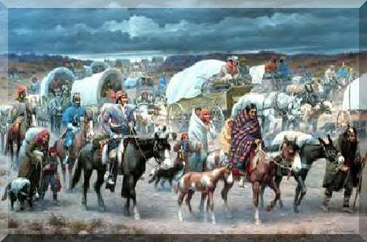
Limits on the Courts’
Power
There are limits to the power of the courts
The Court depends on the executive branch along with state and local officials, to enforce their decisions
  Andrew Jackson vs. Dwight Eisenhower
Congress can get around a Court ruling by passing a new law or changing a law ruled unconstitutional by the court
Congress may also try to pass an amendment to the Constitution
The President has the power to appoint justices and Congress has the power to remove them
Trail of Tears and Andrew Jackson

Slide 9
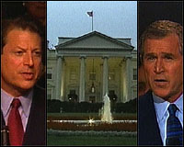
Limits on the Courts’ Power
Congress can vote to remove the Court’s jurisdiction over certain types of cases
The court can only rule on the cases that come to it, all cases must be actual legal disputes
The court will not rule on a law or action that has not been challenged on appeal or is not a federal question
The Court also tries to stay away from political questions since it is not elected and it is not part of its job; Bush v. Gore 2000
Bush v. Gore

Slide 10
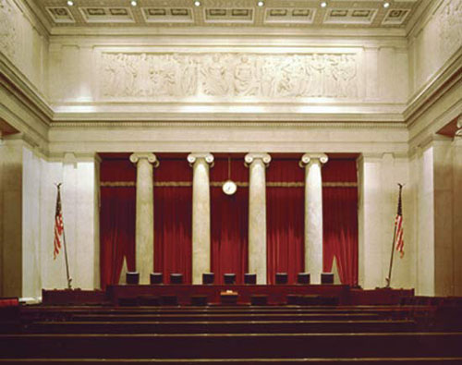
How Cases Reach the Court
The Supreme Court conducts its business each year from October until the following June or July
Each month the justices spend 2 weeks listening to arguments and two weeks writing and studying new cases
From the many cases submitted to them, the justices make a list of cases they want to discuss more carefully
The court will accept a case if four of the nine justices agree to do so, rule of four
Accepted cases go on the Court calendar, called a “docket”
http://www.youtube.com/watch?v=Unyswl36q8w
Inside of the Supreme Court

Slide 11
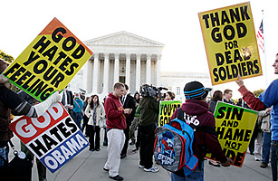
Acceptance by the Court
Each year the court gets more than 7,000 applications, it usually selects fewer than 200 cases to hear
Usually the court takes cases that involve important Constitutional issues such as freedom of speech
http://www.youtube.com/watch?v=ZM6ZzEwJJs0
Once the Court takes a case the lawyers for each side prepare a “brief”
The brief is a written document that explains each side’s position; the justices then study the briefs
Free speech cases can be very controversial

Slide 12
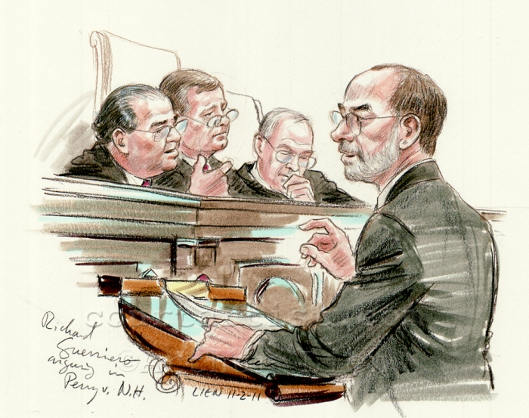
The Court Process
Oral arguments: each side presents oral arguments
Each side typically gets only 30 minutes to summarize their case, the justices are allowed to interrupt the lawyers and ask questions
Conference: On Fridays the justices get together to make their first decisions
These meetings take place in secret and no notes are kept; why?
The chief justice presides over the discussion of the case
A majority decides a case; how many normally? At least six justices have to be present
No video is permitted during oral arguments

Slide 13
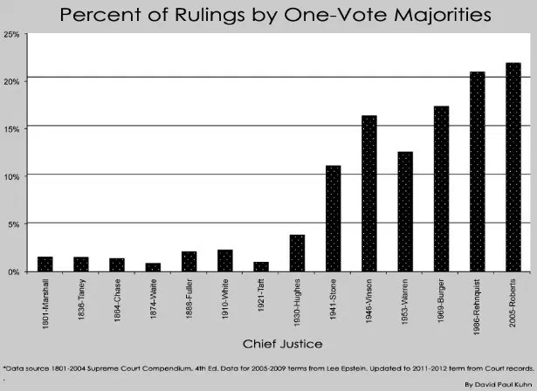
Opinion
Once the Court has reached a decision one justice gets the job of writing the majority opinion
The opinion states the facts of the case, announces the ruling, and explains the ruling
  why are opinions important?
A justice who disagrees with the majority opinion can write a dissenting opinion
  why are these important
A justice who votes with the majority but for different reasons writes a concurring opinion
When the opinion is completed it goes to news reporters and the court website

Slide 14
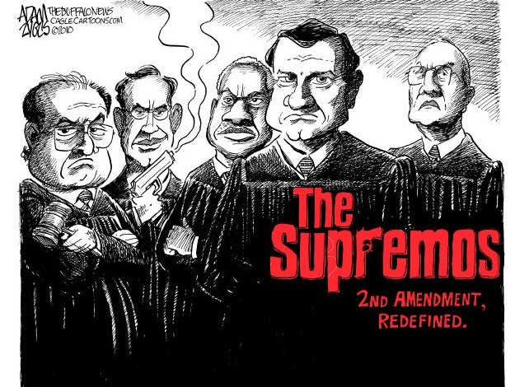
Reasons for Court Decisions
The law is supposed to be the most important influence on a justice’s decisions
Guiding principle: “stare decisis” means “let the decision stand”; significance?
The Supreme Court is in sometimes in a position to overrule outdated precedents
Social Conditions and attitudes are often reflected in the decisions of the court; segregation
Legal Views vary among the justices, some want the court to be more active and others believe they should be more reserved
  Activism vs. Restraint
Justices are also affected by their personal beliefs
There are many things that effect a justices opinion

