Slide 1
Standards and Practices of American Democracy

Slide 2
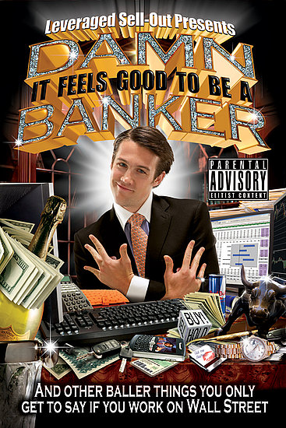
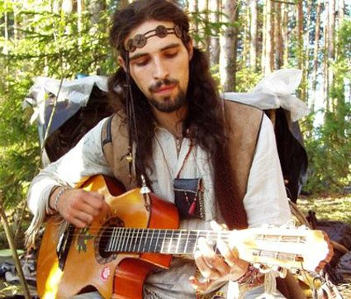
What is politics?
Politics impacts people in a variety of ways throughout their lives
Politics: The process through which a society makes its governing decisions
Although politics is usually associated with government it impacts many organizations; examples?
Political conflict has two main sources; scarcity and differences in value
Politics is the process designed to solve these conflicts
What would happen without political processes?
Hippies v. Bankers

Slide 3
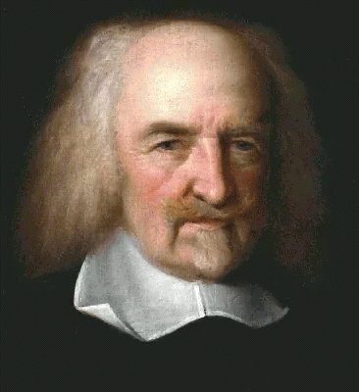
“Nasty, Brutish, and Short” and I’m Not Talking About Freshmen
The US Constitution is an amazing but not entirely original document; it was the culmination of enlightenment thinking
Thomas Hobbes, Leviathan (1651), wrote about the “social contract theory”
State of nature, people constantly at risk of attack, favors strong over weak; in a social contract people surrender some freedom in exchange for protection from a government
Examples today?
Thomas Hobbes, what a happy looking guy

Slide 4
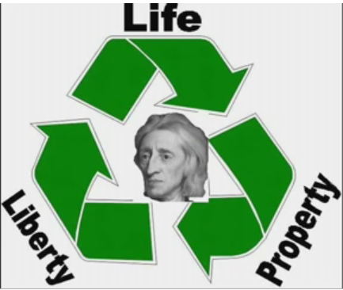
Natural Rights
John Locke, Second Treatise on Civil Government (1690), claimed all people have certain natural rights such as life, liberty, and property; sound familiar?
People enter into a social contract in order to safeguard these rights and if the government fails in this the people have the right to overthrow the government; noticing a theme?
Jean Jacques Rousseau, Social Contract (1762), government must have the consent of the governed to be legitimate protectors of their rights

Slide 5
Declaration of Independence
When in the Course of human events, it becomes necessary for one people to dissolve the political bands which have connected them with another, and to assume among the powers of the earth, the separate and equal station to which the Laws of Nature and of Nature's God entitle them, a decent respect to the opinions of mankind requires that they should declare the causes which impel them to the separation.
We hold these truths to be self-evident, that all men are created equal, that they are endowed by their Creator with certain unalienable Rights, that among these are Life, Liberty and the pursuit of Happiness.--That to secure these rights, Governments are instituted among Men, deriving their just powers from the consent of the governed, --That whenever any Form of Government becomes destructive of these ends, it is the Right of the People to alter or to abolish it, and to institute new Government, laying its foundation on such principles and organizing its powers in such form, as to them shall seem most likely to effect their Safety and Happiness.

Slide 6
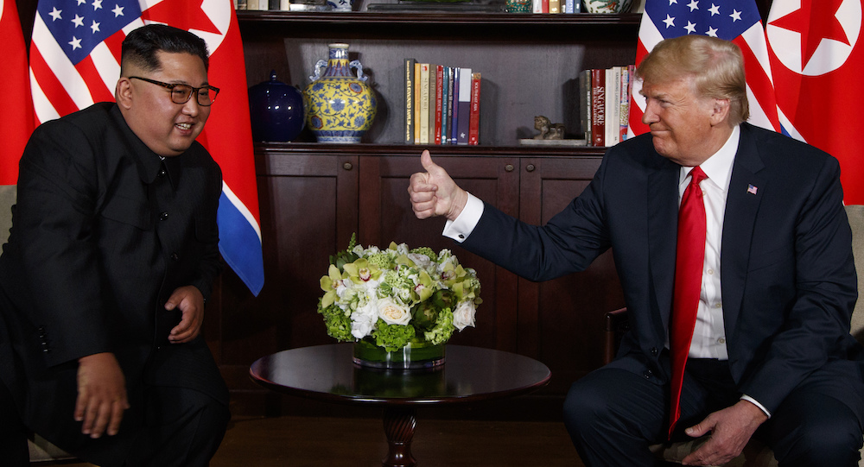
Limited Government
Limited Government: granting the government enough authority to maintain order while making sure the government’s power does not violate it’s purpose of serving the people and protecting their rights
Some government such as totalitarian and authoritarian governments exercise great power and normally fail to serve the will of the people over time
Types of democracy
Participatory Democracy: broad participation by individuals in politics and civil society
Example?
Pluralist Democracy: group-based activism by nongovernment interests to impact policy
Example?
Elite Democracy: political decisions are made by the elites in society
Example?

Slide 7
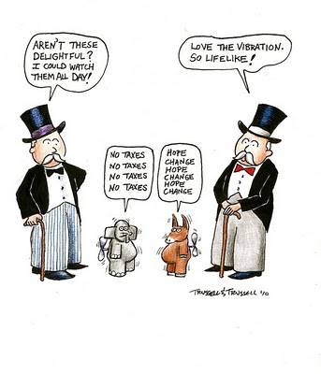
What are the symbols present in this cartoon?
What form of democracy would this cartoon represent?
What causes you to draw that conclusion?

Slide 8
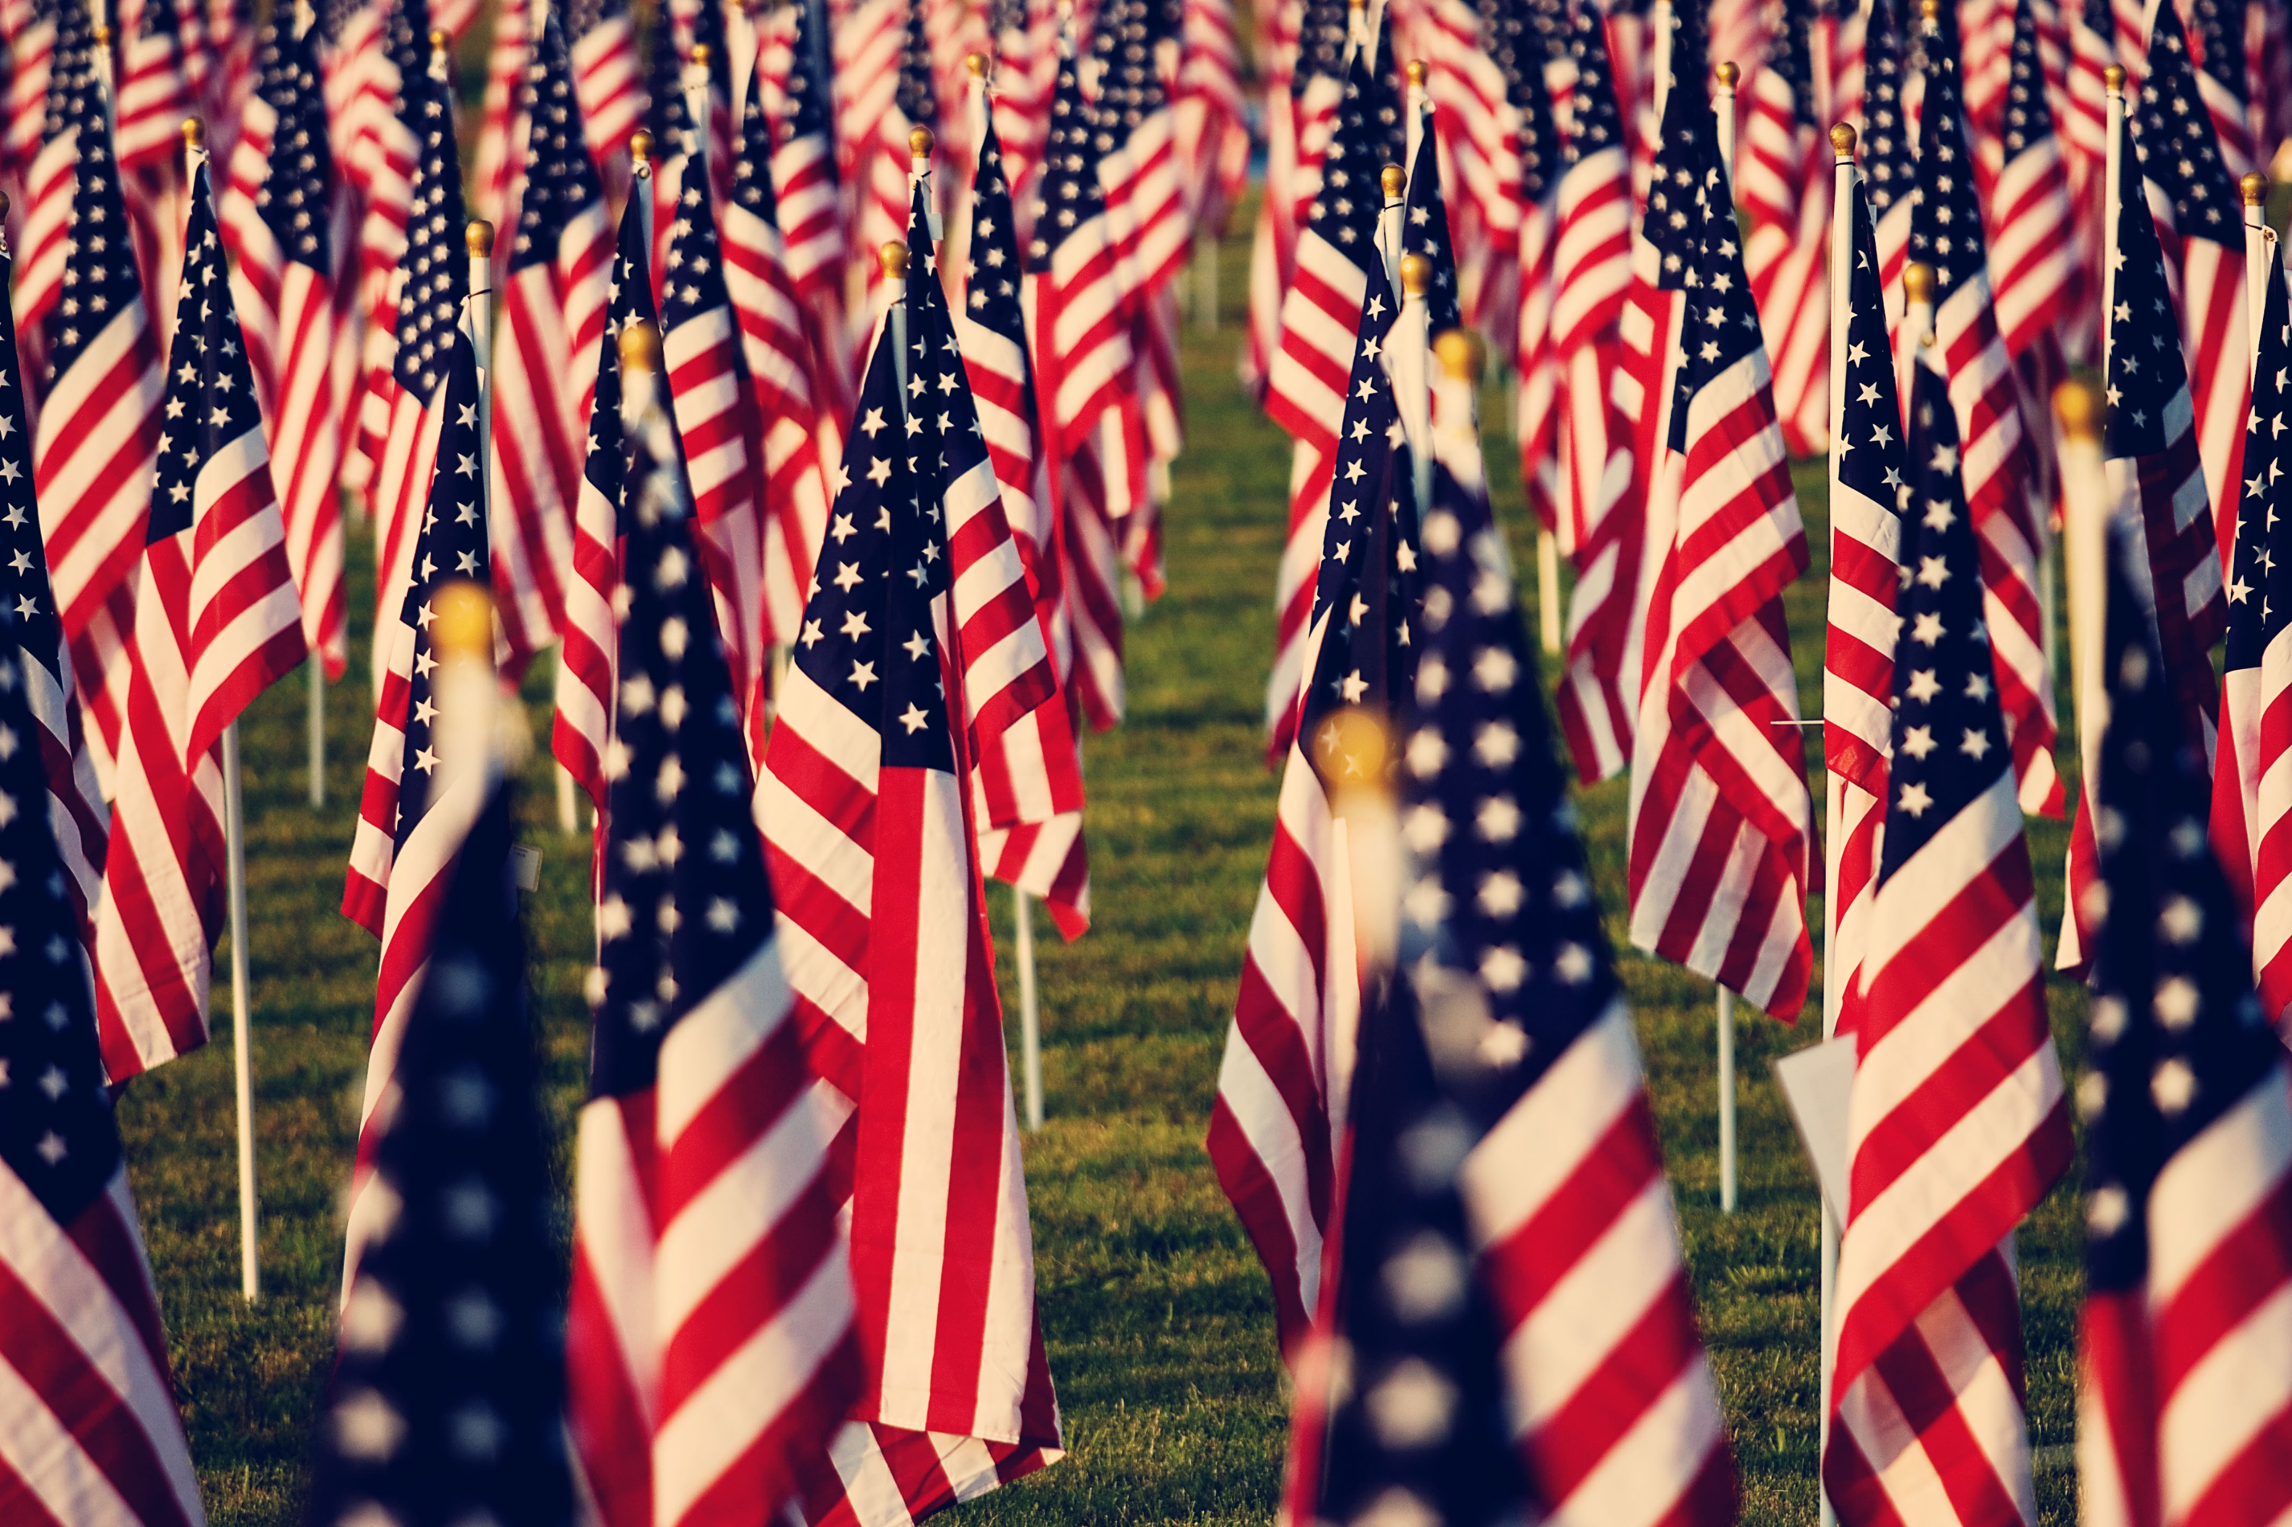
Rules of American Politics
Major rules of American politics include:
democracy (popular sovereignty)
republicanism/constitutionalism
capitalism
Democracy (popular sovereignty) rests on the idea that government authority come from the people, typically expressed through voting
United States is not a pure direct democracy
majority rule is less direct in the US due to the fragmentation of power
positive and negative results?
Why would the founders fear allowing the people to have more say? Are they right?

Slide 9
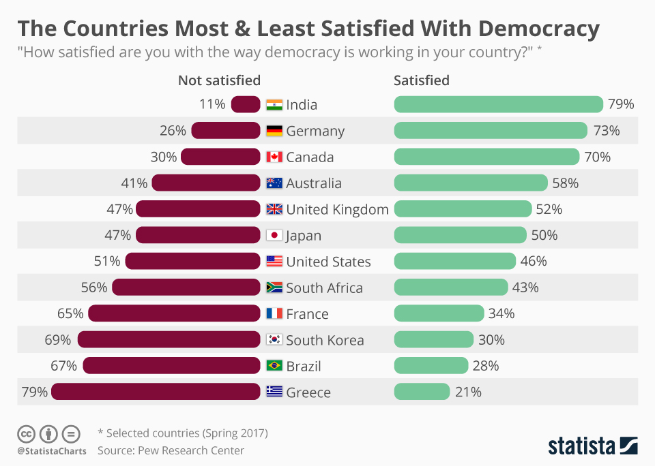
What observations can you make from this chart?
What could be influencing people’s views?
What doesn’t the data show that would be important for analysis?

Slide 10
Constitutionalism
Republicanism/Constitutionalism: there are limits on the power of a government over its citizens; often used to protect minority views
Republicanism doesn’t mean the Republican Party
While no right is absolute, Americans believe individual rights are important
Serves as balance against democratic rule
Why would this sometimes cause conflict and frustration in the United States?

Slide 11
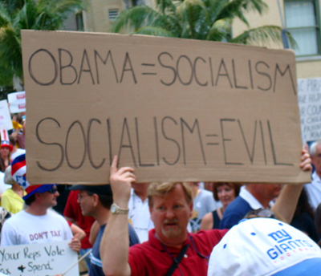
Capitalism
Americans are largely supportive of a capitalist economic system
Socialist and communist candidates and parties have consistently done poorly in the United States, especially when compared to Europe
Capitalism is based on the idea that government interferes in the economy as little as possible and that individuals are free to make their own economic decisions
Americans largely believe that wealth is best distributed through the economy instead of through the government
The idea of “rugged individualism” has permeated American culture; people should take care of themselves and not rely on the government
Has this idea declined?
Much of the opposition to “Obamacare” was fueled by concerns that it was a socialist policy

Slide 12
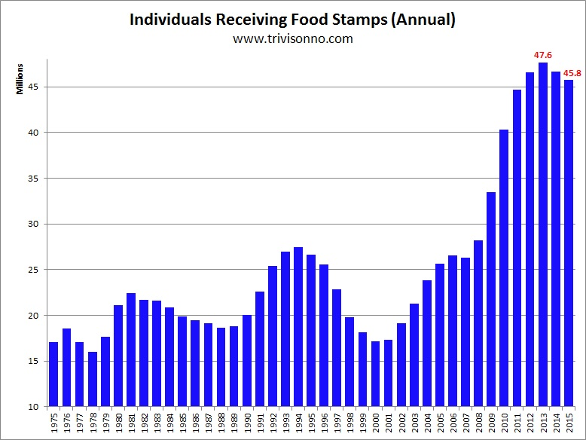
-What could cause this rise in food aid?
-What are the consequences of this trend for the United States?
-What other data would be helpful?

