Slide 1
Political Socialization and Ideology

Slide 2
How American Learn Their Politics
Political socialization: how people acquire their political beliefs
Heavily influenced by culture
Parents are the first agents of political socialization; “my mom says”
Widespread political change is usually preceded by major events; often driven by younger voters
Great Depression, Iran Hostage Crisis and Stagflation, 9/11 (outlier?), Great Recession

Slide 3
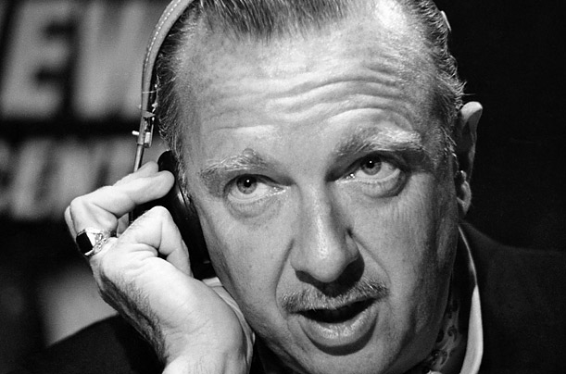
Agents of Political Socialization
Family: dominant force in a young person’s life; KY and the Democratic Party
Schools: extol American values and heroes, pledge of allegiance; how should we teach history?
Mass Media: how media portrays events can greatly impact people’s beliefs; Vietnam war and media coverage
Walter Cronkite and Vietnam?

Slide 4
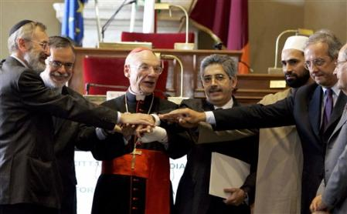
Agents of Political Socialization
Peers: peer groups tend to be largely homogenous in their political thinking; problems today?
Political Institutions and Leaders: citizens will look to political leaders such as the President to explain issues; “bully pulpit”
Religion: most Americans associate themselves with some sort of religious beliefs; impart social and moral values that can influence politics
Religion can have a major impact on people’s political beliefs

Slide 5
Ideology
Ideology: a consistent pattern on particular issues that stems from a core belief or set of beliefs
How do we acquire our ideology?
Many different descriptors, we are going to talk in generalities
All people deviate from their ideology in some instances

Slide 6
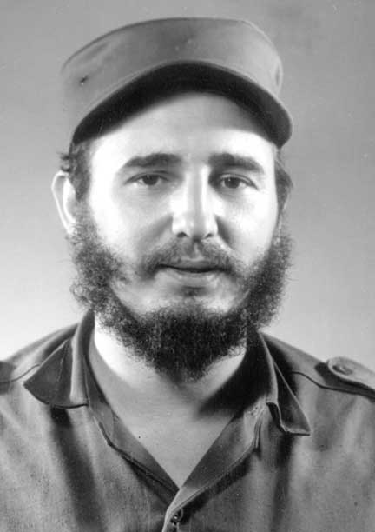
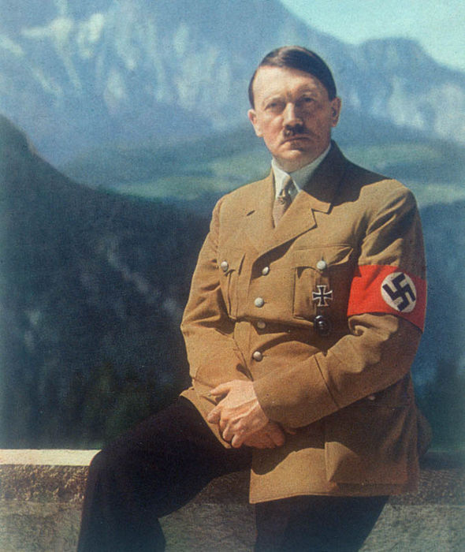
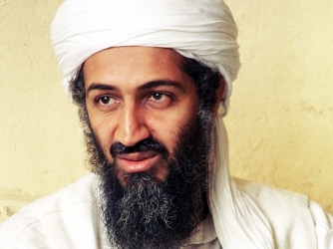
Non-American Ideology
Extreme left wing (liberal) ideologies such as Communism have never gained much support in the United States, they have been tried in many other places in the world, often called radicals
Under communism the government maintains total control over the economy and society and makes the decisions about where to allocate resources
Extreme right wing (conservative) ideologies such as fascism have also never enjoyed widespread support in the United States, examples include Nazism and Islamism, often called reactionary
Supporters of right wing ideologies want to return their countries or people to past glory by returning to more traditional values
Both extreme left and right wing ideologies are typically characterized by violence against dissenting views and have rarely enjoyed long term success as a governing philosophy
Why have these ideologies struggled to find support in the United States?

Slide 7
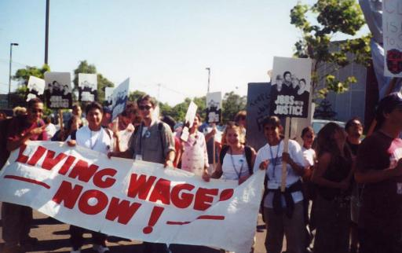
Economic Liberals
Believe government should do more to assist people who have difficulty meeting their economic needs on their own
Support greater welfare benefits for low income Americans, typically paid for by higher taxes on wealthier Americans
Other policies would include support for a higher minimum wage, support for labor unions, greater regulation of business, expanding access to health care (Obamacare)
This philosophy is typically promoted by the Democratic Party

Slide 8
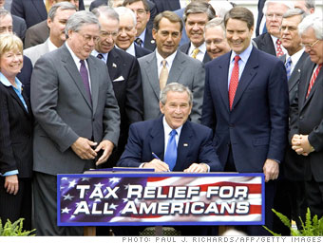
Economic Conservatives
Believe government tries to do too many things that should be left to private interests and economic markets
Support keeping taxes low on individuals and businesses to allow the economy to grow which will generate wealth for all Americans; “a rising tide lifts all boats”
Other policies would include support for the reduction of business regulation, reduction in welfare benefits, controlling government budget deficits, and giving business more freedom to choose who to hire and fire
This philosophy is typically promoted by the Republican party

Slide 9
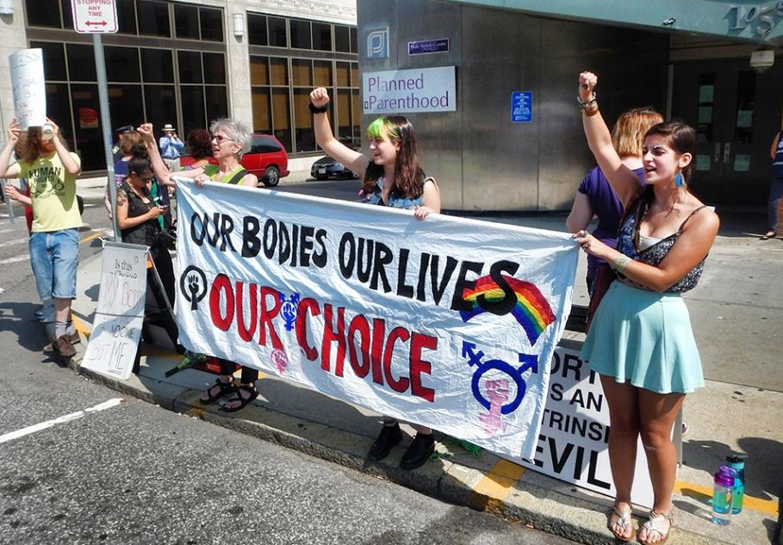
Cultural (Social) Liberals
Believe that government should not promote traditional values and should be open to unconventional or new values
Would include support for things like abortion, gay and transgender rights, women's rights, easing of divorce laws, removal of religious references and ideas from government
Often promote laws to protect people who promote new values, more support in cities
This philosophy is typically promoted by the Democratic Party

Slide 10
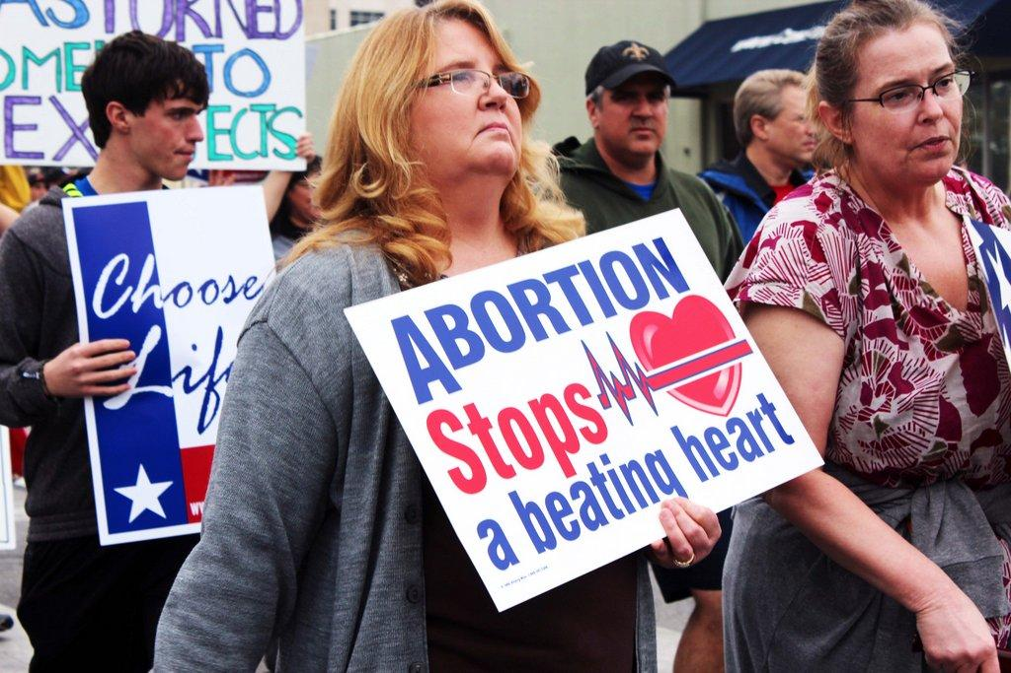
Cultural (Social) Conservatives
Believe that government should promote traditional values and should not encourage new values
Would include support for things like anti-abortion laws, preventing transgender people from using different bathrooms, promoting traditional family structures, allowing religious references and ideas in government, opposition to gay marriage, regulation of violence and sexual content in media
Often promote policies that will encourage people to follow traditional values, more support in rural areas
This philosophy is typically promoted by the Republican Party

Slide 11
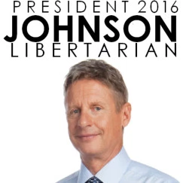
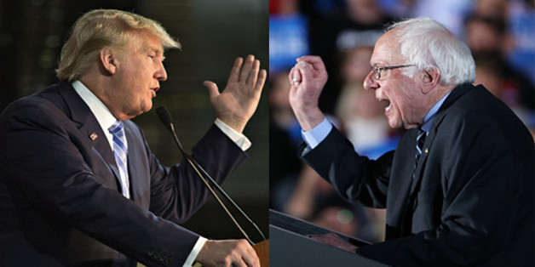
Other Prominent American Ideologies
Libertarian: Believe government should not involve itself in the economy or in upholding traditional values (economic conservative + social liberal)
Believe in more personal freedom and a very limited government
Libertarian party is the largest third party in the country
Populists: Believe government should do more to assist people having economic trouble and should uphold traditional values (economic liberals + social conservatives)
Often seen as appealing to the “common man”
Populists exist in both major parties
Donald Trump has been labeled by some a populist (opposed to reform for Social Security, supports maternity leave, wants to reduce immigration, closer surveillance of Muslims)
Why have many traditional conservatives rejected Trump?
Socialism: a more extreme combination of economic and cultural liberals, want government to do more for people and regulate the economy to a much greater degree
Not typically strong in America, Bernie Sanders

